Slide 1

SIGMA MED
Team Sigma:
Sreeraj S Kumar
Navaneeth C
Akshay Suresh
Abhishek S Kumar
A P Gokul
Abhishek S
Johnjo Benny

Slide 2
Problem Statement
Develop solutions to assist slot booking in hospitals and private clinics .
Improvise the existing system of isolation and quarantining of a locality with disease outbreak.
Develop solutions to reduce the waiting time of patients.
Develop a solution for live interaction of patients with doctor.

Slide 3
Solution
We propose to build a website for slot booking in hospitals and private clinics.
Enabling AI feature to relate similar symptoms in the same locality to identify any disease outbreak.
We propose to update the current token number on a real time basis.
We propose to build a chat bot for live interaction with the doctor.
AI predicting the possibility of patients disease after analysing the symptoms

Slide 4
How It Works
Patient can create and login to an account and can book appointments with the doctors in the nearest hospitals.
Patient can view his appointment status and also keep a check on current token number.
Doctor can access the previous disease history and results and can directly prescribe medicines through his portal.
The application looks for similar symptoms reported in the same locality and can predict and detect the possibility of disease outbreak.
AI predicting the possibility of patients disease after analysing the symptoms

Slide 5
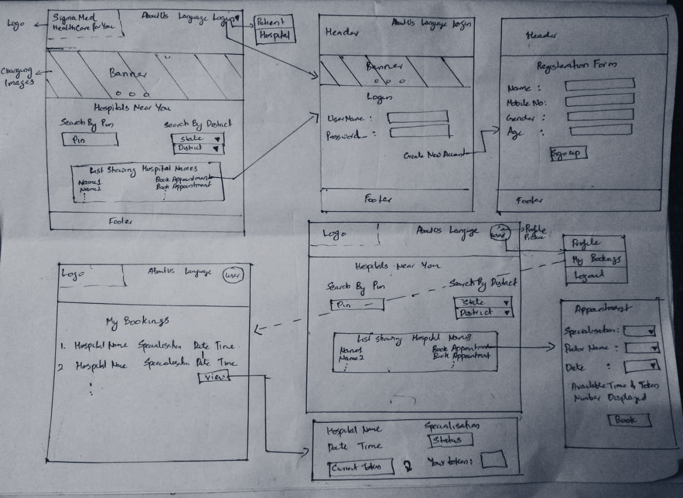
Frontend Wireframe

Slide 6
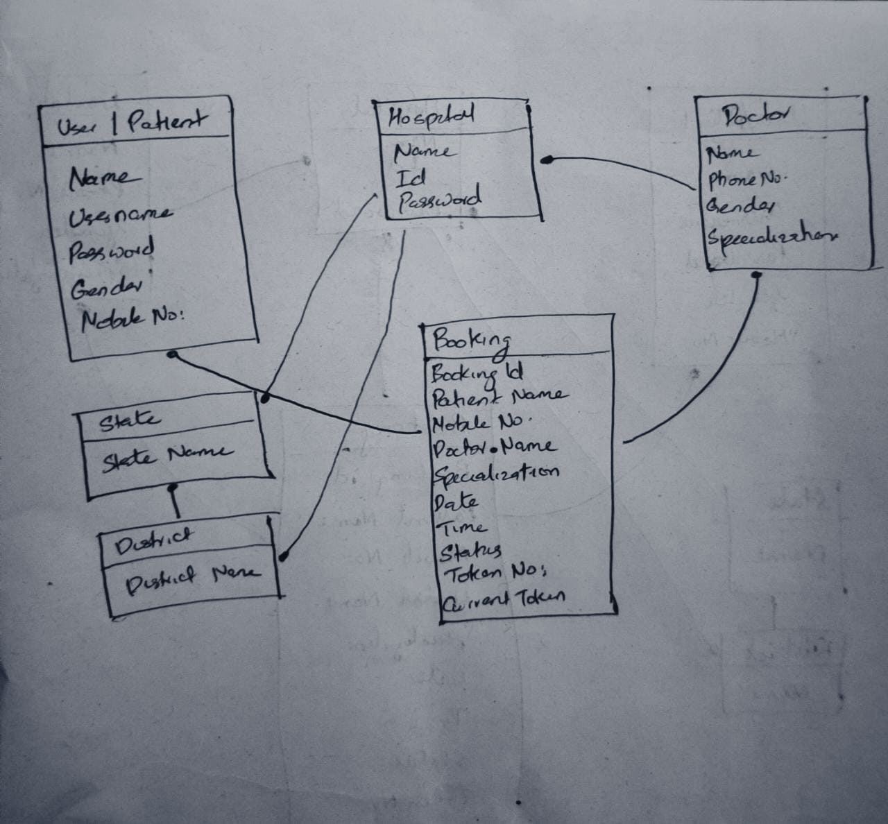
Backend Class Diagram

Slide 7




Tech Stack
Backend:
Back end:
Frontend:

Slide 8
Links
GitHub: https://github.com/severussnape10/sigmamed
Demo: https://sigmamed.herokuapp.com/
Readme:https://github.com/severussnape10/sigmamed/blob/main/README.md

Slide 9
Contributions
Sreeraj S Kumar
-Deployed in heroku.com
-Backend
Navaneeth C
-Frontend
-Wireframe
Akshay Suresh
-Frontend
-Ideation
A P Gokul
-Backend
-Database
Abhishek S
-Frontend
-Presentation
Johnjo Benny
-Backend
-Presentation
Abhishek S Kumar
-Frontend
-Presentation

